Slide 1
Math 8
Chapter 10 Review

Slide 2


Slide 3
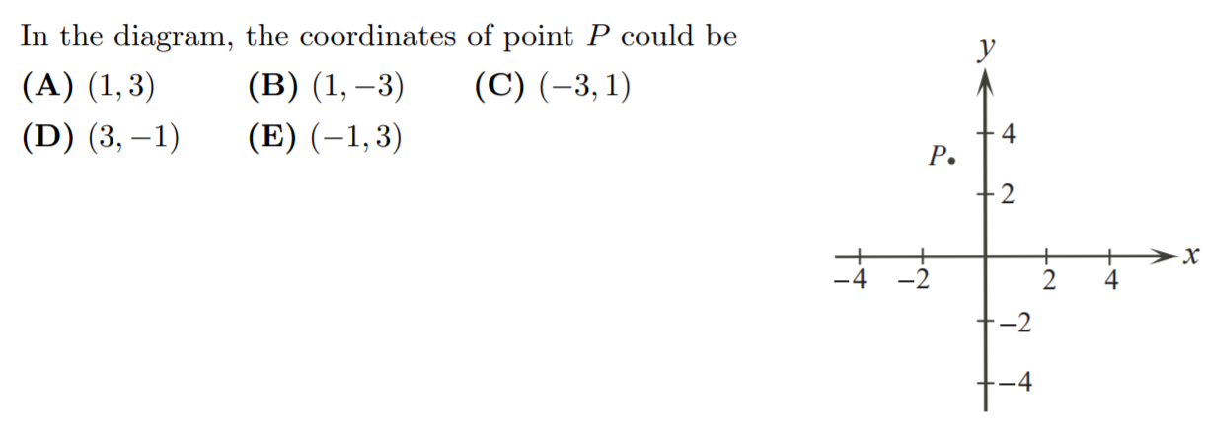

Slide 4


Slide 5


Slide 6


Slide 8


Slide 9


Slide 10


Slide 11
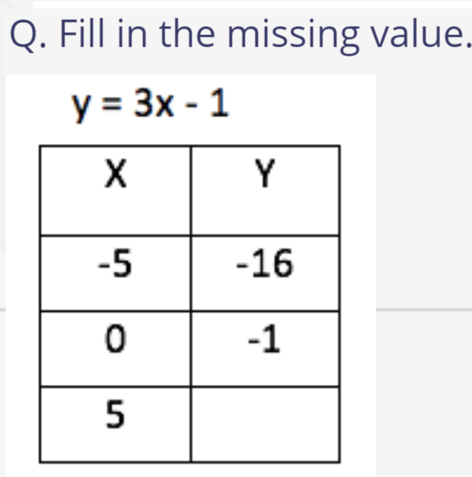
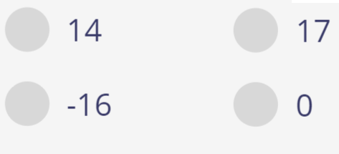
A
C
B
D

Slide 12

A
B
C
D

Slide 13

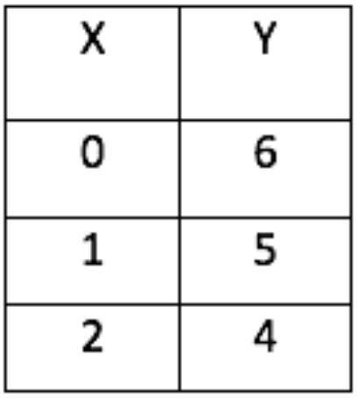
A
B
C
D

Slide 14
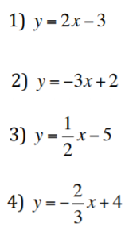
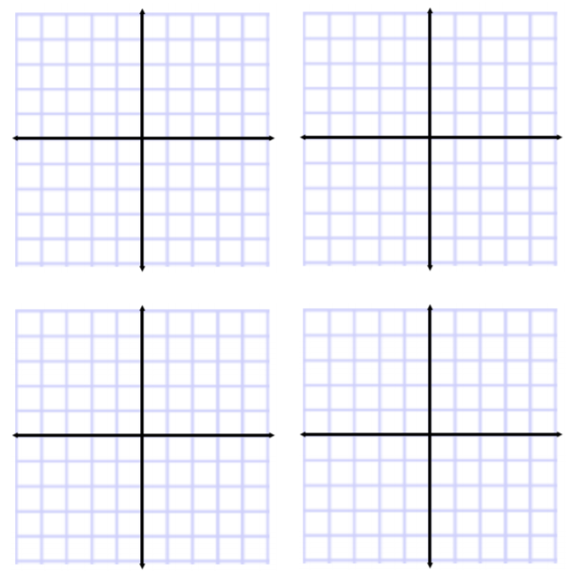
Q: Match each equation with the corresponding graph:
A
B
C
D

Slide 15


